Slide 1
MessMate
Hostel / Mess Meal & Expense Manager
Web Application Development Lab — Final Project
Presented by: Nurjahan Akter · ID: IT23045
Notes:
Introduce yourself and the project: a web app that digitises the paper bazar notebook used in student messes.

Slide 2
Project idea & problem statement
The idea
The problem
Most student messes track meals and bazar costs in a notebook. MessMate is a multi-user web app where members log meals, the manager approves expenses, and the system calculates the meal rate and every person's balance automatically.
Manual hisab is slow and error-prone. Meals get miscounted, receipts get lost, past entries can be changed quietly, and month-end arguments about who owes what are common.
MessMate · 2
Notes:
Explain the motivation using your own hostel experience.

Slide 3
Objectives
Digitise daily meals, bazar expenses and member deposits
Calculate meal rate and each member's cost and balance automatically
Role-based access: Manager and Member, with secure login
Approval workflow so only verified expenses affect the rate
Transparent monthly reports with CSV export and print view
Fully responsive interface that works on a phone
MessMate · 3

Slide 4
Key features
Authentication
Meals
Bazar expenses
Register, login, logout, hashed passwords, session cookie
Members set today/future; manager edits any date
Submit → approve/reject, search and filters
Deposits & balance
Monthly report
Notices & profile
Manager records payments; balances update live
Per-member hisab, categories, CSV, print
Announcements, edit profile, change password
MessMate · 4

Slide 5
User roles
Manager (admin)
Member
Records deposits
Approves or rejects bazar expenses
Edits meals for any member and date
Posts notices
Manages members: role, activate, delete
Sets mess name and breakfast weight
Sets own meals for today or later
Submits bazar expenses for approval
Sees own deposits and balance
Views the shared monthly report
Reads notices, edits own profile
MessMate · 5
Notes:
Authorization is enforced on the server for every API route, not just hidden in the UI.

Slide 6
Technologies used
Front end
HTML5 · CSS3 (responsive + print) · Vanilla JavaScript · Fetch API · Canvas chart
Back end
Node.js built-in http, crypto, fs · REST JSON API · custom router
Database
JSON-file database with atomic writes (temp file → rename)
Security
scrypt password hashing · HMAC-signed HttpOnly cookie · validation · escaping
Tools
Git & GitHub · Render (hosting) · automated smoke tests
MessMate · 6

Slide 7
System architecture & workflow
Browser
HTML · CSS · JS
11 pages
Node.js server
Router · auth · rules
REST /api/*
JSON database
users · meals · deposits
expenses · notices
fetch() JSON + session cookie
Workflow: login → cookie verified on every request → role check → validate input → read/write data → JSON response → UI updates
MessMate · 7

Slide 8
Database design (ER diagram)
MEALS
USERS
DEPOSITS
id (PK)
userId (FK)
date
breakfast, lunch, dinner
id (PK)
name, email (unique), phone
hash, salt
role: admin | member
active, createdAt
id (PK)
userId (FK)
amount, date, note
EXPENSES
NOTICES
id (PK)
title, category, amount, date
addedBy (FK)
status: pending | approved | rejected
One user → many meals, deposits, expenses and notices (1 : N)
id (PK)
title, body
authorId (FK)
createdAt
MessMate · 8
Notes:
Relationships: USERS 1-N MEALS, DEPOSITS, EXPENSES (addedBy) and NOTICES (authorId).

Slide 9
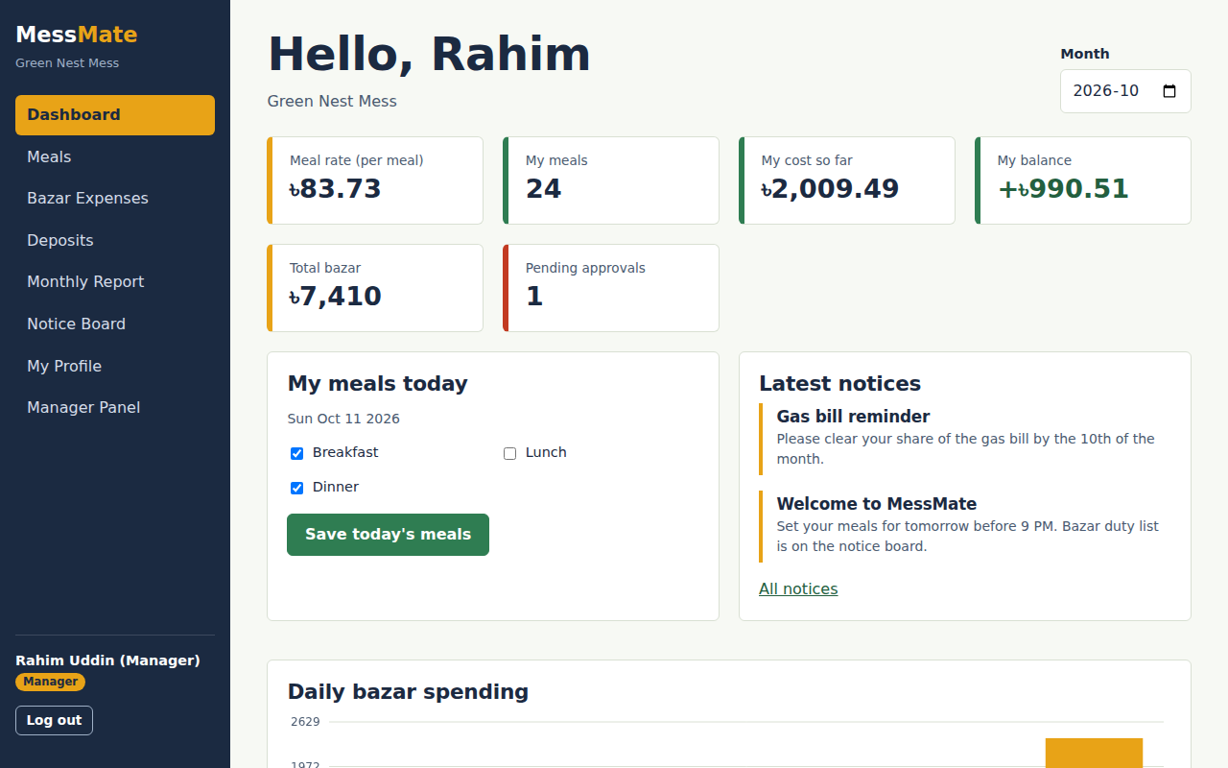
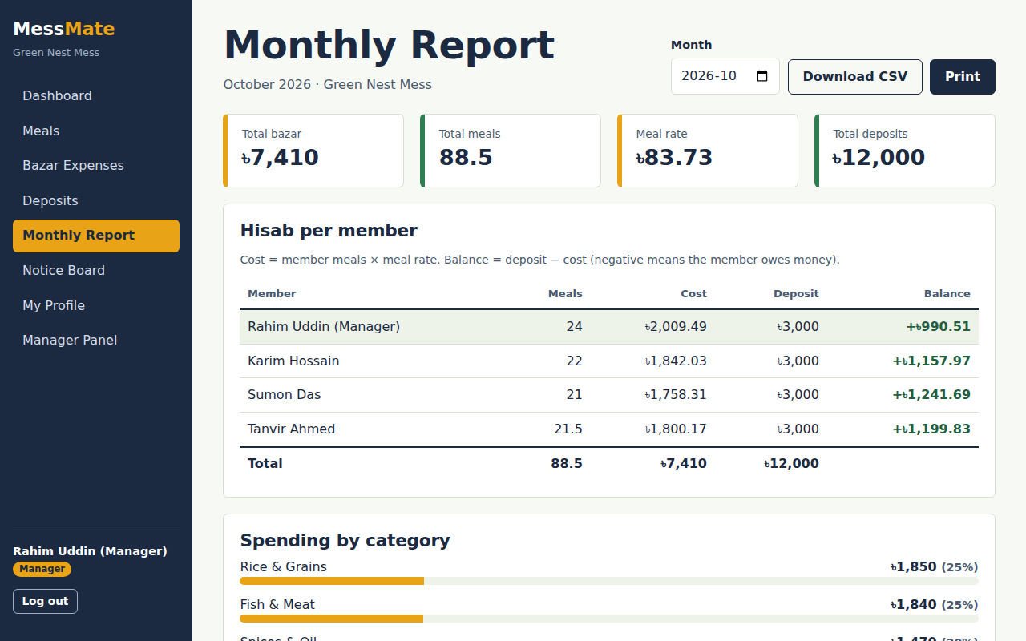
UI screenshots — dashboard & report
Dashboard: meal rate, my balance, today's meals, notices, spending chart
Monthly report: per-member cost, deposit and balance; CSV and print
MessMate · 9

Slide 10
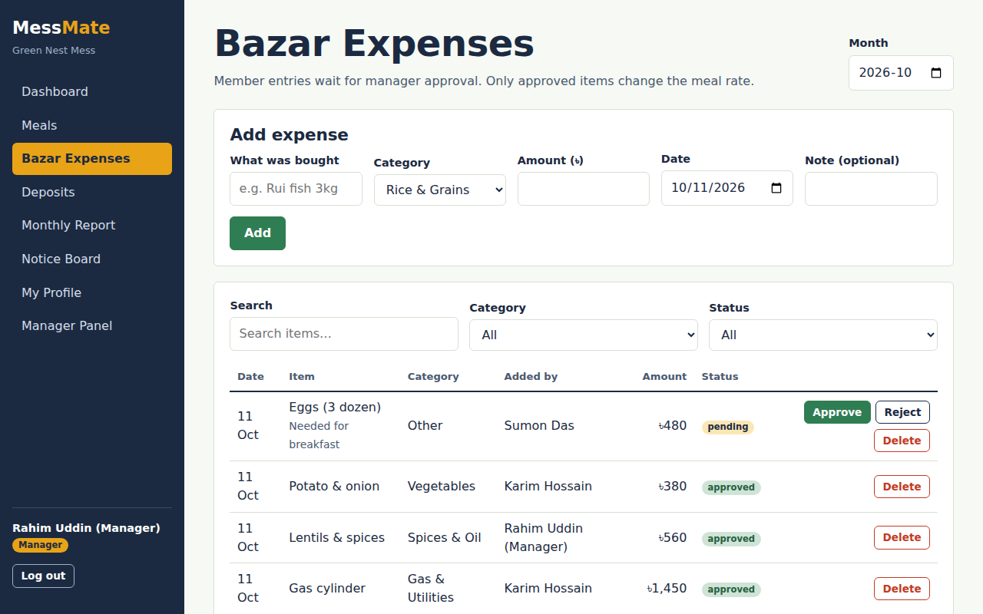
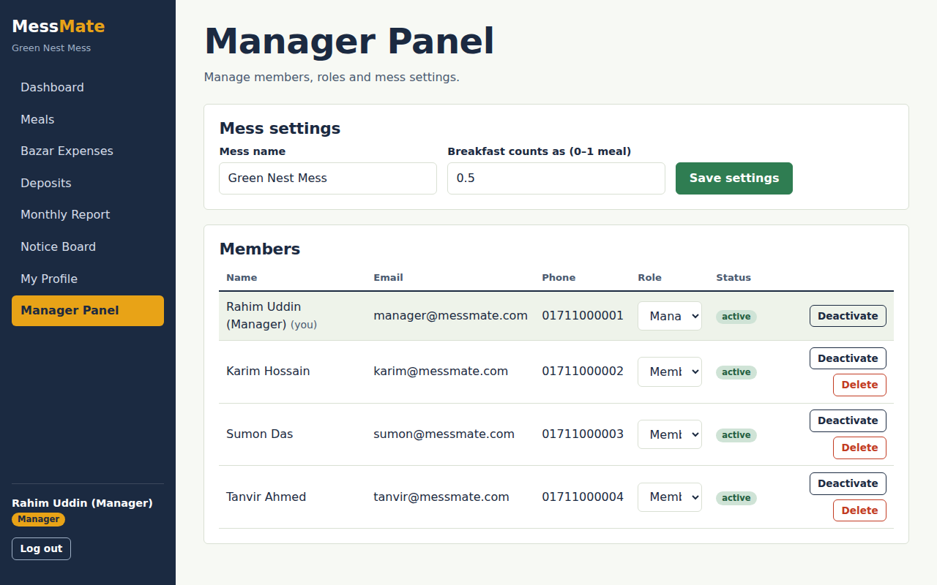
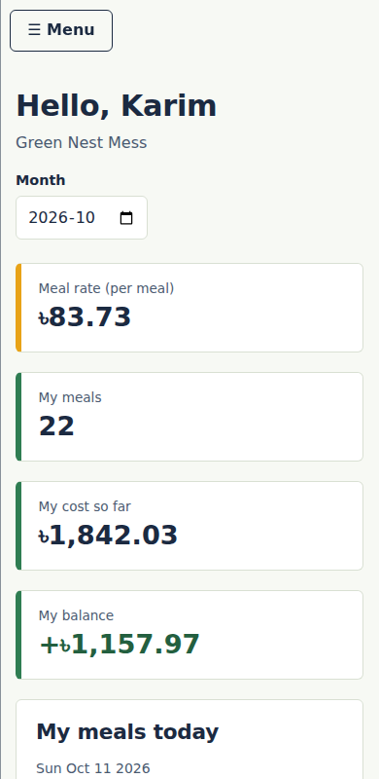
UI screenshots — expenses, manager panel & mobile
Bazar approval workflow
Manager panel: roles & settings
Responsive
MessMate · 10

Slide 11
Implementation highlights
Custom router + 25 REST endpoints in plain Node.js
Server-side rules: members cannot edit past meals; member expenses start as pending
Atomic JSON writes keep the database file safe
Reusable front-end shell: one app.js + one script per page
12 automated API checks (npm test)
weighted meals = breakfast × 0.5
+ lunch + dinner
meal rate = approved expenses
÷ total weighted meals
cost = member meals × rate
balance = deposit − cost
MessMate · 11

Slide 12
Project demonstration & links
Demo flow: register → login as Member → set meals → add expense (pending)
Login as Manager → approve expense → record deposit
Open Monthly Report → show new meal rate → download CSV
Show Manager Panel: change role, deactivate member
GitHub repository
Live website
github.com/Nura-001/MessMate
messmate-792b.onrender.com
MessMate · 12

Slide 13
Challenges & solutions
Accurate money maths
Preventing tampering
Rounded all amounts to 2 decimals; test confirms member costs add up to total expense.
Past-date meal edits blocked on the server, not just in the UI.
Secure sessions without libraries
Data safety
HMAC-signed tokens in HttpOnly cookies using Node crypto.
Write to a temp file then rename, so db.json is never half-written.
MessMate · 13

Slide 14
Future improvements & conclusion
Future improvements
Conclusion
MessMate shows a complete full-stack workflow — front end, REST back end, database, authentication and role-based authorization — solving a real hostel problem with transparent, automatic accounting.
SMS / email reminders
Guest-meal counts
Bazar duty roster
SQL database
Installable mobile app (PWA)
Thank you
MessMate · 14

